Slide 1


CSB4301 – Theory of Computation
B.Tech – IVth Semester
Mr. D.S.John Deva Prasanna AP(SG) & Ms.Vanathi, AP,CSE
Department of Computer Science and Engineering

Slide 2
Epsilon Non Deterministic Finite Automata – ε NFA
ε NFA is very same as NFA except the following differences.
ε NFA states may have transitions to other state by reading a special symbol called epsilon ε.
‘ε’ represents an empty string.
‘ε’ transitions helps in combining smaller automata into larger ones.
ε – NFA s are easier to construct than NFA and DFA.
Any language that is recognized by a NFA and DFA can be recognized by ε NFA too.

Slide 3


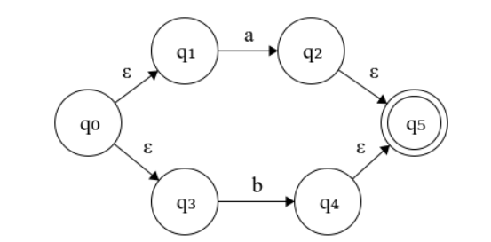
Sample Epsilon NFA
The diagrams show how two small NFAs can be combined to form single NFA using epsilon transitions

Slide 4
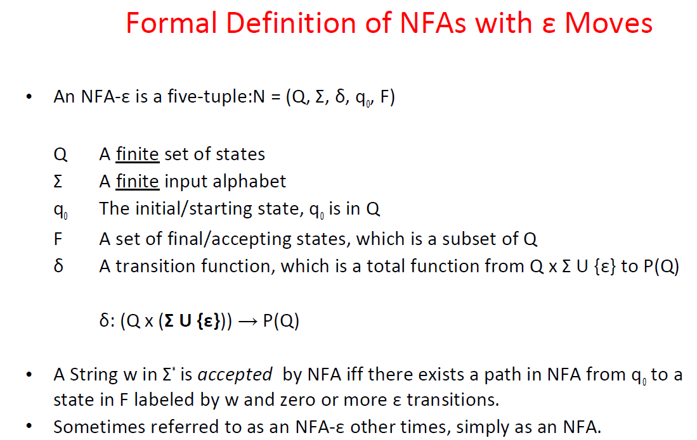

Slide 5
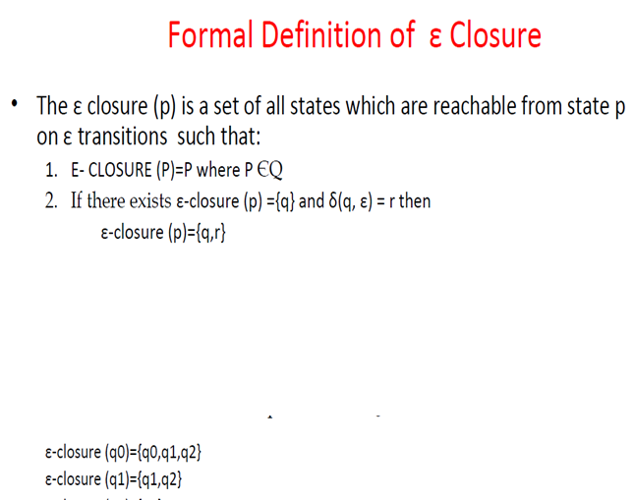
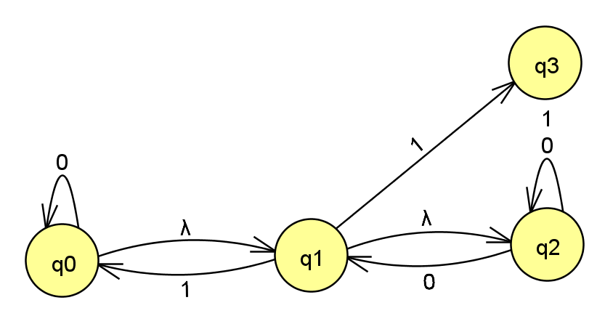

Slide 6
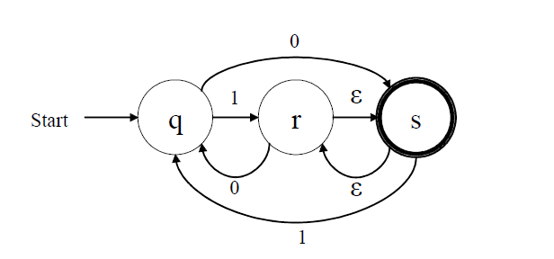
Epsilon Closure
Epsilon closure of a state is simply the set of all states we can reach by following the transition function from the given statethat are labeled ε.
• ε-closure(q) = { q }
• ε-closure(r) = { r, s}

Slide 7
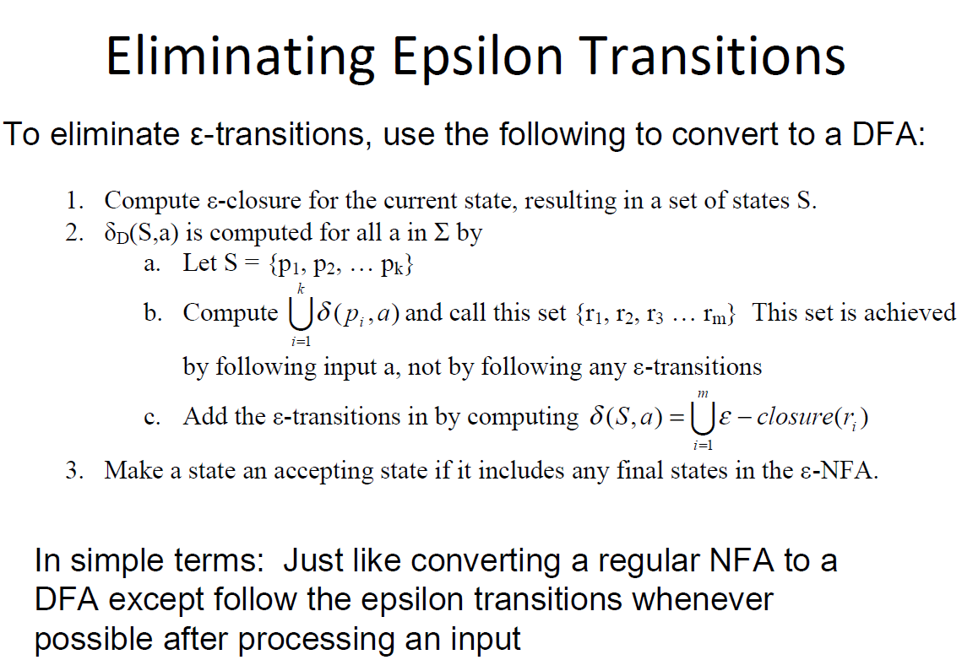

Slide 8
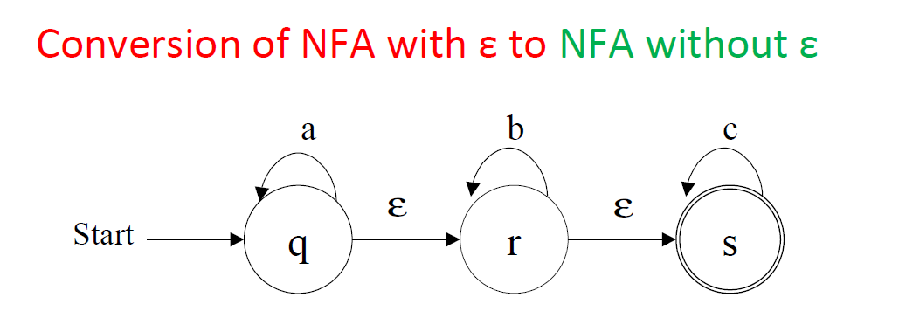

Slide 9
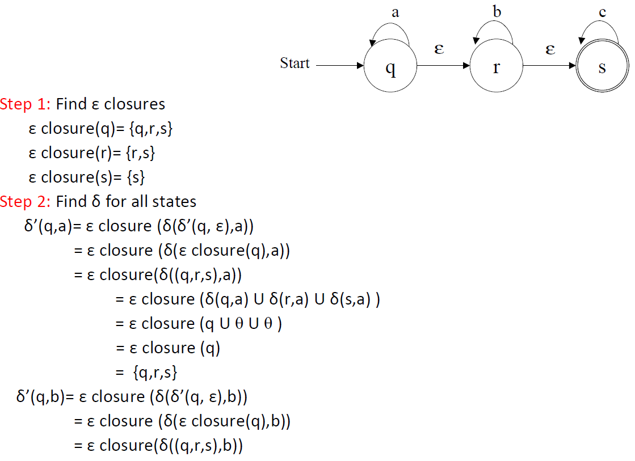
Conversion of epsilon NFA into NFA

Slide 10
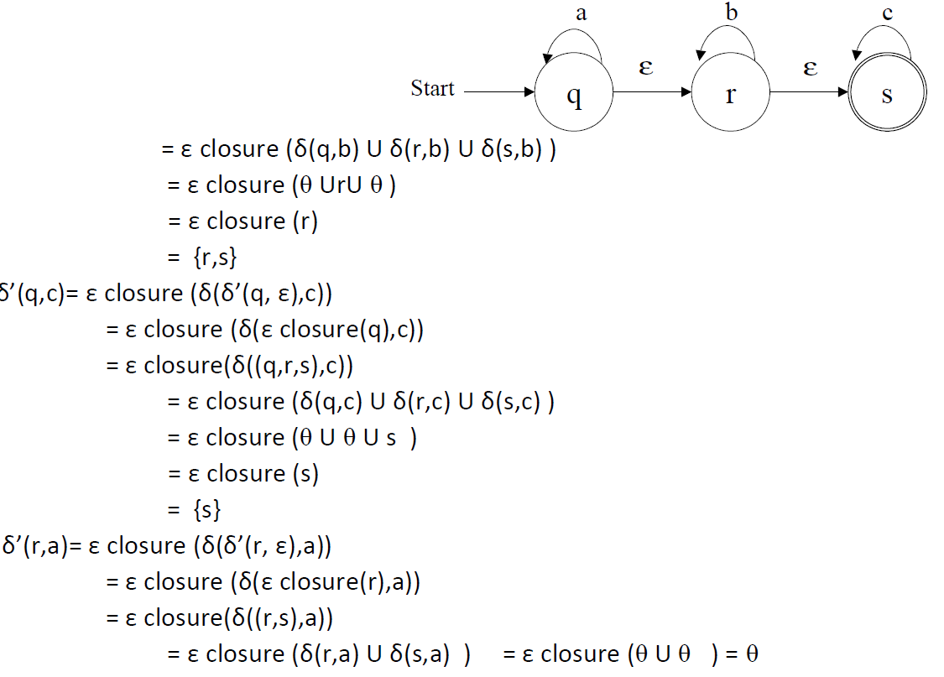
Conversion of epsilon NFA into NFA

Slide 11
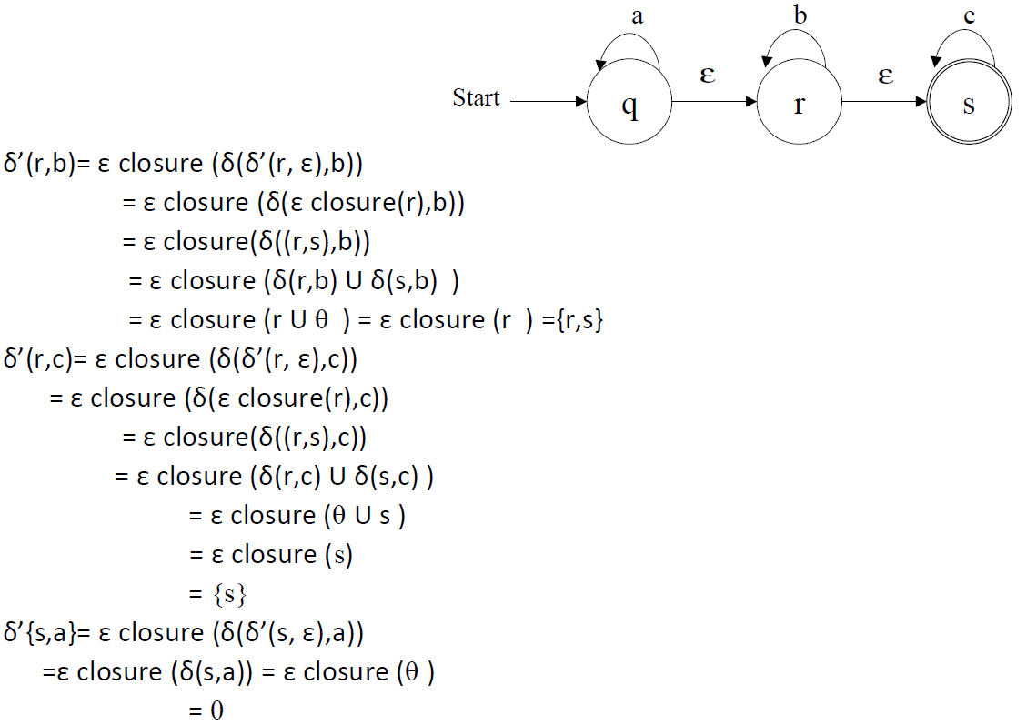
Conversion of epsilon NFA into NFA

Slide 12
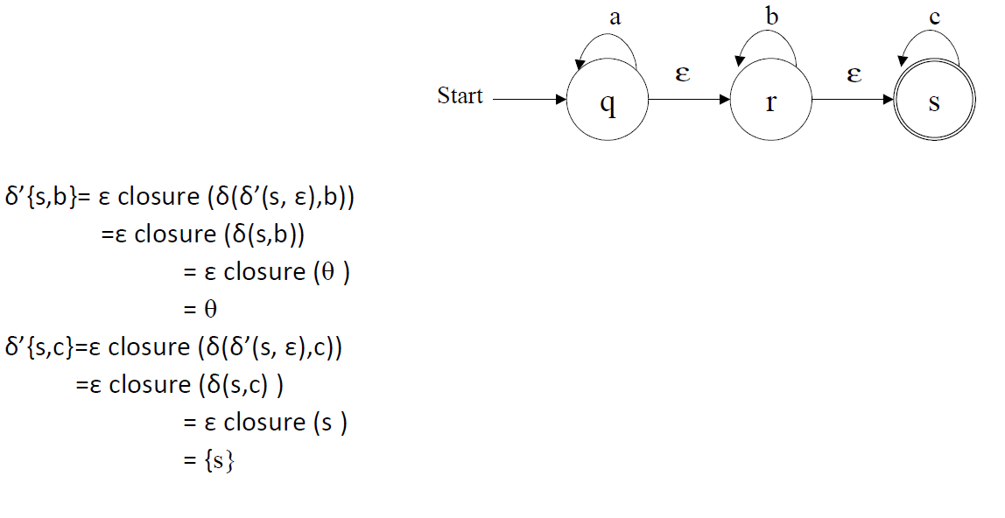
Conversion of epsilon NFA into NFA

Slide 13
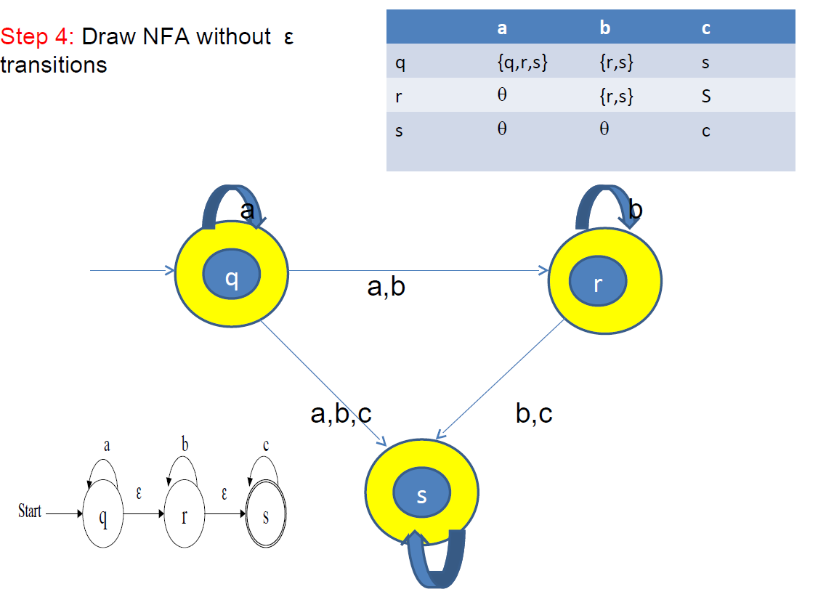
Final Epsilon NFA converted to NFA

Slide 14
Thank You

